Slide 1
UNIT-IV
Run-time Environments:
Storage Organization,
Stack Allocation of Space,
Access to Non local Data on the Stack.
Heap Management,
Introduction to Garbage Collection
Symbol Table Organization:
Structure of Symbol table,
Symbol Table organization for Block Structured and non block Structure languages,
Data Structures of symbol Table.

Slide 2
4.1 Storage Organization
The executing target program runs in its own logical address space in which each program value has a location.
The management and organization of this logical address space is shared between the compiler, operating system, and target machine.
The operating system maps the logical addresses into physical addresses, which are usually spread throughout memory.

Slide 3
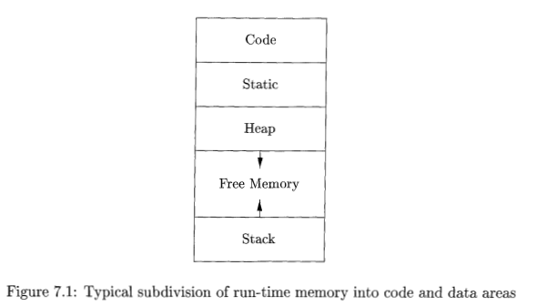
The amount of storage needed for a name is determined from its type.
The storage layout for data objects is strongly influenced by the addressing constraints of the target machine.
The runtime storage might be subdivided into
–Target code
–Data objects
–Stack to keep track of procedure activation
–Heap to keep all other information

Slide 4
An array of ten characters needs only enough bytes to hold ten characters, a compiler may allocate 12 bytes to get the proper alignment, leaving 2 bytes unused. Space left unused due to alignment considerations is referred to as padding
When space is at a premium, a compiler may pack data so that no padding is left; additional instructions may then need to be executed at run time to position packed data so that it can be operated on as if it were properly aligned.

Slide 5
The size of the generated target code is fixed at compile time, so the compiler can place the executable target code in a statically determined area Code, usually in the low end of memory.
Similarly, the size of some program data objects, such as global constants, and data generated by the compiler, such as information to support garbage collection, may be known at compile time, and these data objects can be placed in another statically determined area called Static.
One reason for statically allocating as many data objects as possible is that the addresses of these objects can be compiled into the target code.
To maximize the utilization of space at run time, the other two areas, Stack and Heap, are at the opposite ends of the remainder of the address space. These areas are dynamic; their size can change as the program executes.

Slide 6
These areas grow towards each other as needed.
The stack is used to store data structures called activation records that get generated during procedure calls.
The stack grows towards lower addresses, the heap towards higher.
An activation record is used to store information about the status of the machine, such as the value of the program counter and machine registers, when a procedure call occurs

Slide 7
When control returns from the call, the activation of the calling procedure can be restarted after restoring the values of relevant registers and setting the program counter to the point immediately after the call. Data objects in activation can be allocated on the stack along with other information associated with the activation.
Many programming languages allow the programmer to allocate and deallocate data under program control

Slide 8
A storage-allocation decision is static compiler is looking only at the text of the program, not at what the program does when it executes.
A decision is dynamic if it can be decided only while the program is running.
Many compilers use some combination of the following two strategies for dynamic storage allocation:
1. Stack storage: Local to a procedure are allocated space on a stack. The stack supports the normal call/return policy for procedures.
2. Heap storage: Data that may outlive the call to the procedure that created it is usually allocated on a "heap" of reusable storage. The heap is an area of virtual memory that allows objects or other data elements to obtain storage when they are created and to return that storage when they are invalidated.
To support heap management, "garbage collection" enables the run-time system to detect useless data elements and reuse their storage, even if the programmer does not return their space explicitly.
Automatic garbage collection is an essential feature of many modern languages, despite it being a difficult operation to do efficiently; it may not even be possible for some languages

Slide 9
4.2 Stack Allocation of Space
Almost all compilers for languages that use procedures, functions, or methods as units of user-defined actions manage at least part of their run-time memory as a stack.
Each time a procedure1 is called, space for its local variables is pushed onto a stack, and when the procedure terminates, that space is popped off the stack allows space to be shared by procedure calls whose durations do not overlap in time,
It allows code compilation for a procedure, relative addresses of its nonlocal variables are always the same, regardless of the sequence of procedure calls.

Slide 10
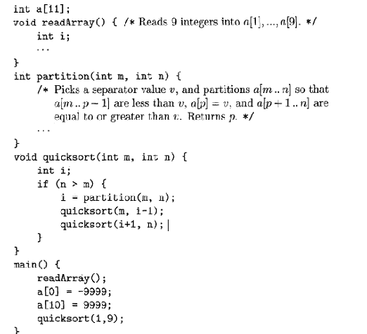
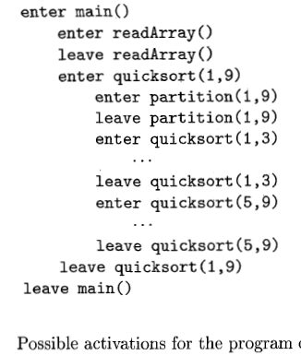
4.2.1 Activation Trees
Stack allocation would not be feasible if procedure calls, or activations of procedures, did not nest in time.

Slide 11
A tree can be used, called an activation tree, to depict the way control enters and leaves activations
The root represents the activation of main program
Each node represents an activation of procedure
The node a is parent of b if control flows from a to b
The node a is to the left of node bif lifetime of a occurs before b

Slide 12
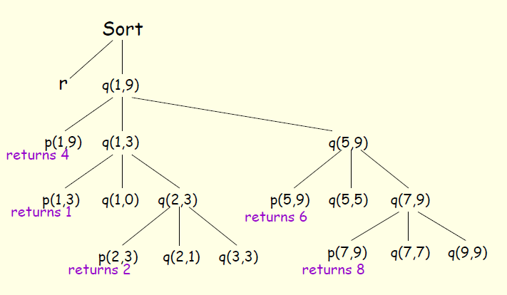

Slide 13
In this execution, the call to partition(l,9) returns 4, so a[l] through a[3] hold elements less than its chosen separator value v, while the larger elements are in a[5] through a[9].
If an activation of procedure p calls procedure q, then that activation of q must end before the activation of p can end. There are three common cases:
1. The activation of q terminates normally. Then in essentially any language, control resumes just after the point of p at which the call to q was made.
2. The activation of q, or some procedure q called, either directly or indirectly, aborts; i.e., it becomes impossible for execution to continue. In that case, p ends simultaneously with q
3. The activation of q terminates because of an exception that q cannot handle. Procedure p may handle the exception, in which case the activation of q has terminated while the activation of p continues, although not necessarily from the point at which the call to q was made. If p cannot handle the exception, then this activation of p terminates at the same time as the activation of q, and presumably the exception will be handled by some other open activation of a procedure

Slide 14
4.2.2 Activation Records
Procedure calls and returns are usually managed by a run-time stack called the control stack.
Each live activation has an activation record (sometimes called a frame) on the control stack, with the root of the activation tree at the bottom, and the entire sequence of activation records on the stack corresponding to the path in the activation tree to the activation where control currently resides.
The latter activation has its record at the top of the stack

Slide 15
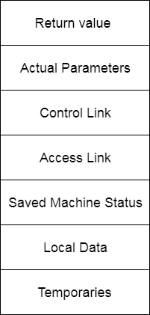
Activation Records
•temporaries: used in expression evaluation
•local data: field for local data
•saved machine status: holds info about machine status before procedure call
•access link : to access non local data
•control link : points to activation record of caller
•actual parameters: field to hold actual parameters
•returned value: field for holding value to be returned
A general activation record

Slide 16
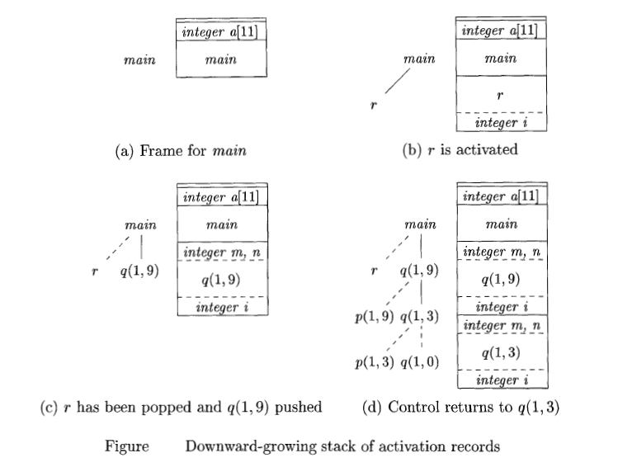

Slide 17
Array a is global, space is allocated for it before execution begins with an activation of procedure main, as shown in Fig. (a).
When control reaches the first call in the body of main, procedure r is activated, and its activation record is pushed onto the stack (Fig. (b)).
The activation record for r contains space for local variable i. Recall that the top of stack is at the bottom of diagrams. When control returns from this activation, its record is popped, leaving just the record for main on the stack.
Control then reaches the call to q (quicksort) with actual parameters 1 and 9, and an activation record for this call is placed on the top of the stack, as in Fig. (c)
No trace of data local to r will be available to q(l,9). When q(l,9) returns, the stack again has only the activation record for main.
Several activations occur between the last two snapshots in Fig.
A recursive call to q(1,3) was made. Activations p(l,3) and q(1,0) have begun and ended during the lifetime of q(l,3), leaving the activation record for q(l,3) on top Fig (d)

Slide 18
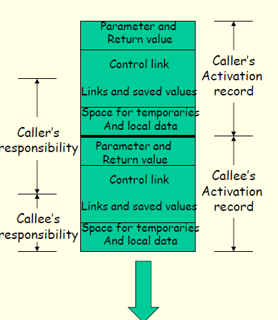
4.2.3 Calling Sequences
A call sequence allocates an activation record and enters information into its field
A return sequence restores the state of the machine so that calling procedure can continue execution

Slide 19
Call Sequence
Caller evaluates the actual parameters
Caller stores return address and other values (control link) into callee’s activation record
Callee saves register values and other status information
Callee initializes its local data and temporary data

Slide 20
Return Sequence
Callee places a return value next to activation record of caller
Restores registers using information in status field
Branch to return address
Caller copies return value into its own activation record

Slide 21
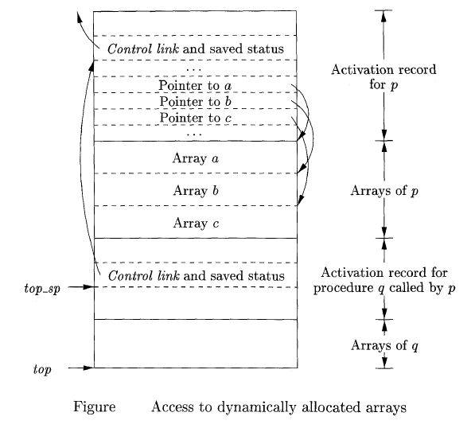
4.2.4.Variable-Length Data on the Stack
Variable length data is allocated after temporaries, and there is a link to from local data to that array.

Slide 22
There are two flavors of variable-length data.
Data obtained by malloc/new have hard to determine lifetimes and are stored in the heap instead of the stack.
Data, such as arrays with bounds determined by the parameters are still stack (if A calls B, these variables of A are allocated before and released after the corresponding variables of B).
The goal is for the (called) procedure to be able to access these arrays using addresses determinable at compile time even though the size of the arrays (and hence the location of all but the first) is not know until the program is called and indeed often differs from one call to the next.
The solution is to leave room for pointers to the arrays in the AR.
These are fixed size and can accessed using static offsets. When the procedure is invoked and the sizes are known, the pointers are filled in and the space allocated.
This is used on a call to tell where the new allocation record should begin.

Slide 23
The run-time memory-management system must deal frequently with the allocation of space for objects the sizes of which are not known at compile time, but which are local to a procedure and thus may be allocated on the stack
The stack can be used only for an object if it is local to a procedure and becomes inaccessible when the procedure returns.
A common strategy for allocating variable-length arrays (i.e., arrays whose size depends on the value of one or more parameters of the called procedure) is shown in Fig, which works for objects of any type if they are local to the procedure called and have a size that depends on the parameters of the call.

Slide 24
Procedure p has three local arrays, whose sizes cannot be determined at compile time.
The storage for these arrays is not part of the activation record for p, although it does appear on the stack.
Only a pointer to the beginning of each array appears in the activation record itself.
When p is executing, pointers are at known offsets from the top-of-stack pointer.
The target code can access array elements through these pointers.

Slide 25
The activation record for a procedure q, called by p. The activation record for q begins after the arrays of p, and any variable-length arrays of q are located.
Access to the data on the stack is through two pointers, top and top-sp, top marks the actual top of stack; it points to the position at which the next activation record will begin.
The second, top-sp is used to find local, fixed-length fields of the top activation record.
top-sp points to the end of this field in the activation record for q
The control-link field for q, which leads us to the place in the activation record for p where top-sp pointed when p was on top.

Slide 26
The code to reposition top and top-sp can be generated at compile time, in terms of sizes that will become known at run time.
When q returns, top-sp can be restored from the saved control link in the activation record for q.
The new value of top is (the old unrestored value of) top-sp minus the length of the machine-status, control and access link, return-value, and parameter fields in q's activation record.
This length is known at compile time to the caller, although it may depend on the caller, if the number of parameters can vary across calls to q.

Slide 27
Dangling Reference
Whenever a storage is de-allocated, the problem of dangling references may occur.
main () {
int *p;
p = dangle();
}
int *dangle*() {
int i=2;
return &i;
}

Slide 28
4.3 Access to Nonlocal Data on the Stack
In languages, all variables are defined either within a single function or outside any function ("globally").
It is impossible to declare one procedure whose scope is entirely within another procedure.
A global variable v has a scope consisting of all the functions that follow the declaration of v, except where there is a local definition of the identifier v.
Variables declared within a function have a scope consisting of that function only, or part of it, if the function has nested blocks

Slide 29
4.3.1 Data Access without Nested Procedures
For languages that do not allow nested procedure declarations, allocation of storage for variables and access to those variables is simple:
Global variables are allocated static storage. The locations of these variables remain fixed and are known at compile time.
To access any variable that is not local to the currently executing procedure uses the statically determined address.
Any other name must be local to the activation at the top of the stack.
Accessing these variables through the top-sp pointer of the stack.
An important benefit of static allocation for globals is that declared procedures may be passed as parameters or returned as results.
static-scoping rule, and without nested procedures, any name non-local to one procedure is nonlocal to all procedures

Slide 30
4.3.2 Issues With Nested Procedures
With nested procedures a complication arises. Say g is nested inside f. So g can refer to names declared in f.
These names refer to objects in the AR for f; the difficulty is finding that AR when g is executing.
We can't tell at compile time where the (most recent) AR for f will be relative to the current AR for g since a dynamically-determined number of routines could have been called in the middle.
int f (int y)
{
g(y);
return y+1;
}

Slide 31
4.3.3 A Language With Nested Procedure Declarations
The C family of languages do not support nested procedures, introduced one of the most influential is ML, and it is this language whose syntax and semantics we shall borrow
ML is a functional language, meaning that variables, once declared and initialized, are not changed.
There are only a few exceptions, such as the array, whose elements can be changed by special function calls.

Slide 32
Variables are defined, and have their unchangeable values initialized, by a statement of the form:
val (name) = (expression)
Functions are defined using the syntax:
fun (name) ( (arguments) 1 = (body)
For function bodies we shall use let-statements of the form:
let (list of definitions) in (statements) end
The definitions are normally val or fun statements.
The scope of each such definition consists of all following definitions, up to the in, and all the statements up to the end.
Most importantly, function definitions can be nested.
For example, the body of a function p can contain a let-statement that includes the definition of another (nested) function q. Similarly, q can have function definitions within its own body, leading to arbitrarily deep nesting of functions.

Slide 33
4.3.4 Nesting Depth
Let us give nesting depth 1 to procedures that are not nested within any other procedure.
For example, all C functions are at nesting depth 1. If a procedure p is defined immediately within a procedure at nesting depth i, then give p the nesting depth i + 1.
Func1()
{ Funct2();
Funct3();
}

Slide 34
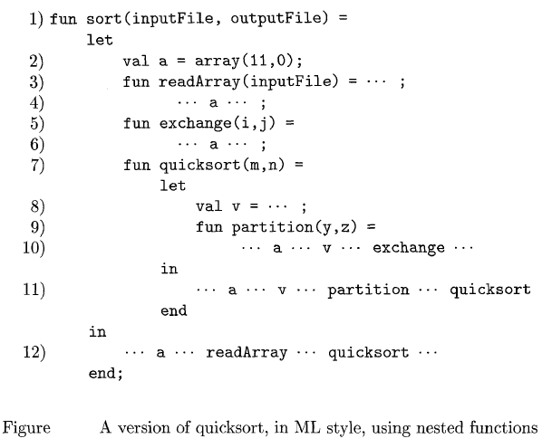

Slide 35
The only function at nesting depth 1 is the outermost function, sort, which reads an array a of 9 integers and sorts them using the quicksort algorithm.
Defined within sort, at line (2), is the array a itself.
The first argument of array says we want the array to have 11 elements; all ML arrays are indexed by integers starting with 0. The second argument of array says that initially, all elements of the array a hold the value 0.
This choice of initial value lets the ML compiler deduce that a is an integer array, since 0 is an integer, so we never have to declare a type for a.
Also declared within sort are several functions: readArray, exchange, and quicksort. On lines (4) and (6) we suggest that readAmy and exchange each access the array a.

Slide 36
Note that in ML, array accesses can violate the functional nature of the language, and both these functions actually change values of a's elements, as in the C version of quicksort.
Since each of these three functions(readArray, exchange, and quicksort) is defined immediately within a function at nesting depth 1, their nesting depths are all 2.
Lines (7) through (11) show some of the detail of quicksort.
Local value v, the pivot for the partition, is declared at line (8).
Function partition is defined at line (9).
In line (10) partition accesses both the array a and the pivot value v, and also calls the function exchange. Since partition is defined immediately within a function at nesting depth 2, it is at depth 3.
Line(11) suggests that quicksort accesses variables a and v, the function partition, and itself recursively.
Line (12) suggests that the outer function sort accesses a and calls the two procedures readArray and quicksort.

Slide 37
4.3.5 Access Links
A direct implementation of the normal static scope rule for nested functions is obtained by adding a pointer called the access link to each activation record.
If procedure p is nested immediately within procedure q in the source code, then the access link in any activation of p points to the most recent activation of q.
Note that the nesting depth of q must be exactly one less than the nesting depth of p.
Access links form a chain from the activation record at the top of the stack to a sequence of activations at progressively lower nesting depths.
Along this chain are all the activations whose data and procedures are accessible to the currently executing procedure.

Slide 38
Suppose that the procedure p at the top of the stack is at nesting depth n, and p needs to access x, which is an element defined within some procedure q that surrounds p and has nesting depth n.
Note that n, 5 n,, with equality only if p and q are the same procedure. To find x, we start at the activation record for p at the top of the stack and follow the access link n, - n, times, from activation record to activation record.
Finally, we wind up at an activation record for q, and it will always be the most recent (highest) activation record for q that currently appears on the stack.
This activation record contains the element x that we want. Since the compiler knows the layout of activation records, x will be found at some fixed offset from the position in q7s activation record that we can reach by following the last access link

Slide 39
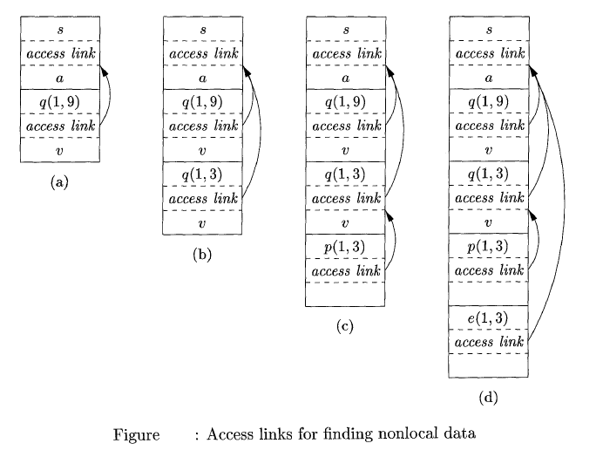

Slide 40
Example : Figure shows a sequence of stacks that might result from execution of the function sort .
Fig. (a), we see the situation after sort has called readArray to load input into the array a and then called quicksort(l,9) to sort the array. The access link from quicksort(1,9) points to the activation record for sort, not because sort called quicksort but because sort is the most closely nested function surrounding quicksort in the program of Fig.

Slide 41
In successive steps of Fig. we see a recursive call to quicksort(1,3), followed by a call to partition, which calls exehange.
Notice that quicksort(1,3)'s access link points to sort, for the same reason that quicksort(1,9)'s does.
In Fig. (d), the access link for exchange bypasses the activation records for quicksort and partition, since exchange is nested immediately within sort.
That arrangement is fine, since exchange needs to access only the array a, and the two elements it must swap are indicated by its own parameters i and j.

Slide 42
4.3.6 Manipulating Access Links
Code to setup access links is part of the calling sequence
Suppose procedure 𝑞 at depth 𝑛𝑞 calls procedure 𝑝 at depth 𝑛𝑝
The code for setting up access links depends upon whether or not the called procedure is nested within the caller

Slide 43
Case 1: 𝑛𝑞<𝑛𝑝
Called procedure 𝑝 is nested more deeply than 𝑞
Therefore, 𝑝 must be declared in 𝑞, or the call by 𝑞 will not be within the scope of 𝑝
Access link in 𝑝 should point to the access link of the activation record of the caller 𝑞
Case 2: 𝑛𝑝==𝑛𝑞
Procedures are at the same nesting level
Access link of called procedure 𝑝 is the same as 𝑞

Slide 44
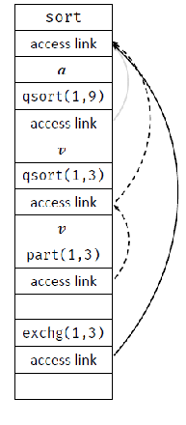
Case 3: 𝑛𝑞>𝑛𝑝
For the call within 𝑞 to be in the scope of 𝑝, 𝑞 must be nested within some procedure 𝑟, while 𝑝 is defined immediately within 𝑟
Top activation record for 𝑟 can be found by following chain of access links for 𝑛𝑞−𝑛𝑝+1 hops
Start in the activation record for 𝑞
Access link for 𝑞 will go to the activation for 𝑟
Nesting depth of exchange is 2
Nesting depth of partition is 3

Slide 45
4.3.7 Access Links for Procedure Parameters
When a procedure p is passed to another procedure q as a parameter, and q then calls its parameter (and therefore calls p in this activation of q), it is possible that q does not know the context in which p appears in the program.
It is impossible for q to know how to set the access link for p.
The solution : when procedures are used as parameters, the caller needs to pass, along with the name of the procedure-parameter, the proper access link for that parameter.
The caller always knows the link, since if p is passed by procedure r as an actual parameter, then p must be a name accessible to r, and therefore, r can determine the access link for p exactly as if p were being called by r directly.

Slide 46
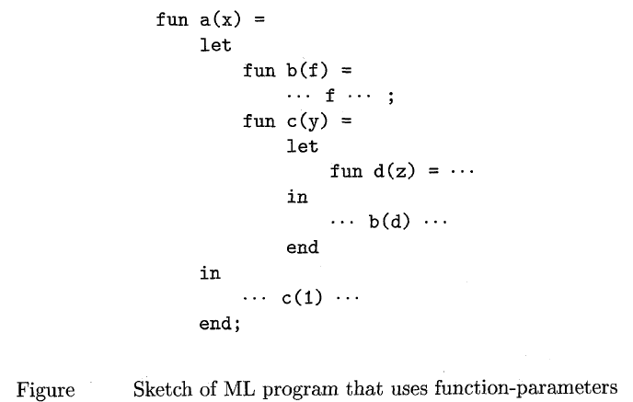
Function a that has
functions b and c nested
within it.
Function b has a
function-valued Parameter f,
which it calls.
Function c defines within it a
function d, and c then calls b
with actual parameter d

Slide 47
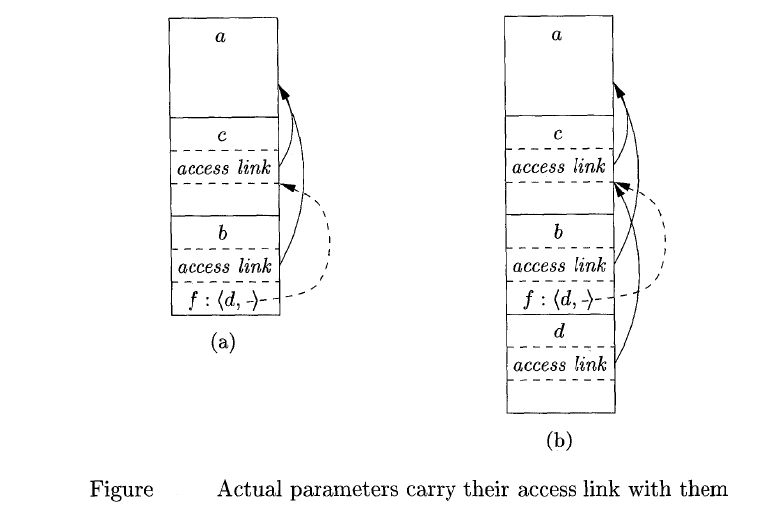

Slide 48
Let us trace what happens when a is executed. First, a calls c, so we place an activation record for c above that for a on the stack.
The Access link for c points to the record for a, since c is defined immediately within a.
Then c calls b(d).
The calling sequence sets up an activation record for b, as shown in Fig. a.
Within this activation record is the actual parameter d and its access link, which together form the value of formal parameter f in the activation record for b.
Notice that c knows about d, since d is defined within c, and therefore c passes a pointer to its own activation record as the access link.
No matter where d was defined, if c is in the scope of that definition, then one of the three rules must apply, and c can provide the link

Slide 49
Now, let us look at what b does. We know that at some point, it uses its parameter f , which has the effect of calling d.
An activation record for d appears on the stack, as shown in Fig.(b).
The proper access link to place in this activation record is found in the value for parameter f; the link is to the activation record for c, since c immediately surrounds the definition of d.
Notice that b is capable of setting up the proper link, even though b is not in the scope of c’s definition.

Slide 50
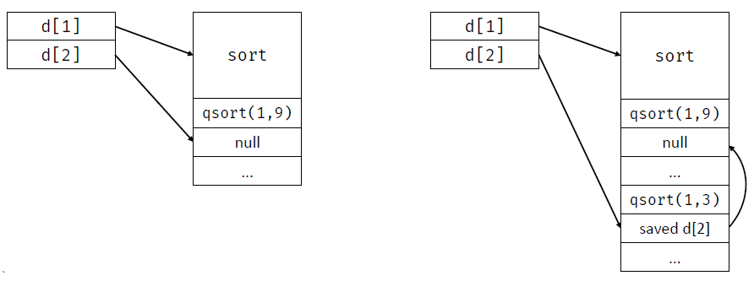
4.3.8.Displays
Display is a global array to hold the activation record pointers for the most recent activations of procedures at each lexical level

Slide 51
Insight in Using Displays
Suppose a procedure 𝑝 is executing and needs to access element 𝑥 belonging to procedure 𝑞
The runtime only needs to search in activations from 𝑑[𝑖], where 𝑖 is the nesting depth of 𝑞
Follow the pointer 𝑑[𝑖] to the activation record for 𝑞, where in 𝑥 should be defined at a known offset

Slide 52
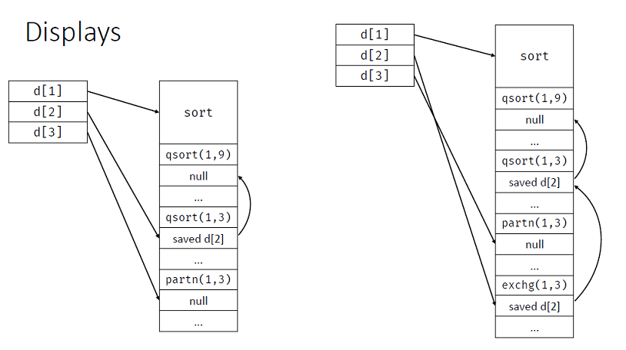

Slide 53
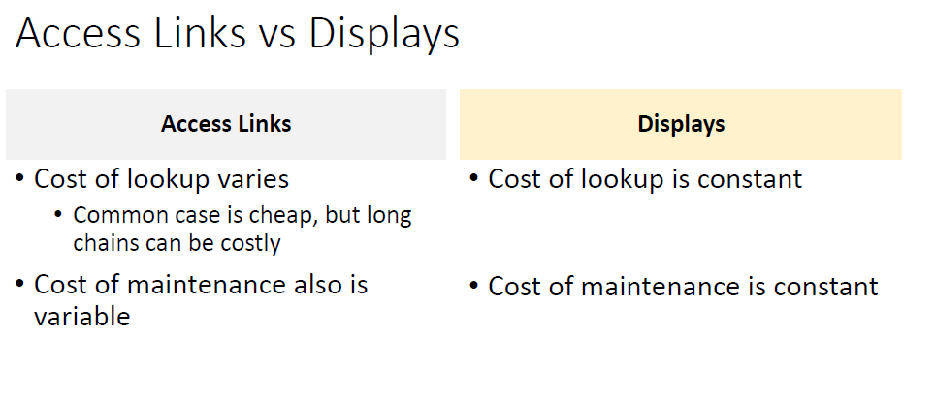

Slide 54
4.4 Heap Management
The heap is the portion of the store that is used for data that lives indefinitely, or until the program explicitly deletes it.
While local variables typically become inaccessible when their procedures end
Interface to the heap: allocate(size)and free(addr)
Commonly-used interfaces are malloc()/free() in C or new/delete in C++
Allocation and deallocation may be completely manual (C/C++), semi-automatic (Java), or fully automatic (Lisp)

Slide 55
Manages heap memory by implementing mechanisms for allocation and deallocation
- Either manual or automatic strategies
Goals
- Space efficiency–minimize fragmentation
- Program efficiency –take advantage of locality of objects in memory and make the program run faster
- Low overhead –allocation and deallocation must be efficient

Slide 56
4.4.1 The Memory Manager
The subsystem that allocates and deallocates space with in the heap. The memory manager keeps track of all the free space in heap storage at all times.
This serves as an interface between application programs and operating system
Allocation: Produces chuck of contiguous heap memory of requested size. If no chuck of required size in available, it increases the heap storage by getting consecutive bytes of virtual memory from OS
Deallocation: The memory manager returns deallocated space to the pool of free space, so it can reuse the space to satisfy other allocation requests.
Memory managers typically do not return memory to the operating system, even if the program's heap usage drops.

Slide 57
Properties of memory managers:
Space Efficiency:
A memory manager should minimize the total heap space needed by program. Doing so allows larger programs to run in a fixed virtual address space. Space efficiency is achieved by minimizing "fragmentation”.
Program Efficiency:
A memory manager should make good use of the memory subsystem to allow programs to run faster.
The non random clustered way in which typical programs access memory. The placement of objects in memory, the memory manager can make better use of space and make the program run faster
Low Overhead:
To minimize the overhead — the fraction of execution time spent performing allocation and deallocation.
The cost of allocations is dominated by small requests.
The overhead of managing large objects is less important, because it usually can be amortized over a larger amount of computation.

Slide 58
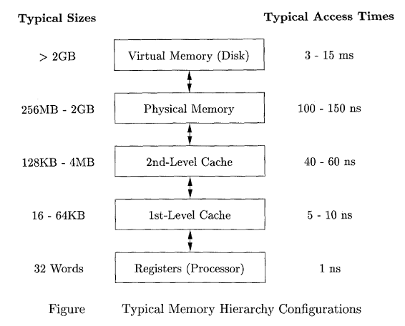
4.4.2 The Memory Hierarchy of a Computer

Slide 59
Data is transferred as blocks of contiguous storage.
To amortize the cost of access, larger blocks are used with the slower levels of the hierarchy.
Between main memory and cache, data is transferred in blocks known as cache lines, which are typically from 32 to 256 bytes long.
Between virtual memory(disk) and main memory, data is transferred in blocks known as pages, typically between 4K and 64K bytes in size.

Slide 60
4.4.3 Locality in Programs
Also known as locality of reference
Most programs exhibit a high degree of locality; that is, they spend most of their time executing a relatively small fraction of the code and touching only a small fraction of the data.
A program has temporal locality if the memory locations it accesses are likely to be accessed again within a short period of time (Eg: Instruction in body of inner loops)
A program has spatial locality(When a new instruction is executed, there is a high probability that the next instruction also will be executed) if memory locations close to the location accessed are likely also to be accessed within a short period of time.(Eg: Traversing the elements in one dimensional array)
The conventional wisdom is that programs spend 90% of their time executing 10% of the code.

Slide 61
Reasons:
Programs often contain many instructions that are never executed.
Programs built with components and libraries use only a small fraction of the provided functionality.
Requirements change and programs evolve, legacy systems often contain many instructions that are no longer used.
Only a small fraction of the code that could be invoked is actually executed in a typical run of the program.
The typical program spends most of its time executing innermost loops and tight recursive cycles in a program.
Instructions belonging to the same loop or same function also have a high probability of being executed together.

Slide 62
4.4.4 Reducing Fragmentation
The beginning of program execution, the heap is one contiguous unit of free space.
The program allocates and deallocates memory, space is broken up into free and used chunks of memory, and the free chunks need not reside in a contiguous area of the heap.
Free chunks of memory as holes. With each allocation request, the memory manager must place the requested chunk of memory into a large-enough hole.
Unless a hole of exactly the right size is found, we need to split some hole, creating smaller hole

Slide 63
Each deallocation request, the freed chunks of memory are added back to the pool of free space
Coalesce contiguous holes is combining adjacent chunks of the heap from a large chunk.
The memory may end up getting fragmented, consisting of large numbers of small, noncontiguous holes. It is then possible that no hole is large enough to satisfy a future request, even though there may be sufficient aggregate free space.

Slide 64
How to Satisfy a request of size n from a list of free holes
First-fit: allocate the first hole that is big enough
Best-fit: allocate the smallest hole that is big enough, must search entire list, unless ordered by size and produces the smallest left over hole
Worst-fit: Allocate the largest hole and also search entire list and produces the largest leftover hole

Slide 65
4.5 Introduction to Garbage Collection
Data that cannot be referenced is generally known as garbage.
High-level programming languages- automatic garbage collection, which deallocates unreachable data

Slide 66
4.5.1 Design Goals for Garbage Collectors
Garbage collection is the process of restoring chunks of storage space that a program could no longer access.
A user program, which we shall refer to as the mutator, modifies the collection of objects in the heap.
The mutator creates objects by acquiring space from the memory manager, and the mutator may introduce and drop references to existing objects.

Slide 67
A Basic Requirement: Type Safety
All languages are not good candidates for automatic garbage collection
garbage collector tells whether any given data element or component of a data element is, or could be used as, a pointer to a chunk of allocated memory space
A language in which the type of any data component can be determined is said to be type safe
Type-safe languages like ML can determine types at compile time.
Type- safe languages, like Java cannot be determined at compile time, but can be determined at run time.
The other called dynamically typed languages. If a language is neither statically nor dynamically type safe, then it is said to be unsafe(eg: C and C++, are bad candidates for automatic garbage Collection)

Slide 68
Performance Metrics
Overall Execution Time: Garbage collection can be very slow. It is important not to increase the total run time of an application. Since the garbage collector necessarily must touch a lot of data, its performance is determined greatly by how it leverages the memory subsystem.
Space Usage: It is important that garbage collection avoid fragmentation and make the best use of the available memory.
Pause Time: Simple garbage collectors are notorious for causing programs- the mutators - to pause suddenly for an extremely long time, as garbage collection kicks in without warning. The minimizing the overall execution time, it is desirable that the maximum pause

Slide 69
4.5.2 Reachability
Reachability becomes a bit more complex when the program has been optimized by the compiler.
First, a compiler may keep reference variables in registers.
Second, even though in a type-safe language programmers do not get to manipulate memory addresses directly, a compiler often does so for the sake of speeding up the code.

Slide 70
Optimizing compiler can do to enable the garbage collector to find the correct root set:
The compiler can restrict the invocation of garbage collection to only certain code points in the program, when no "hidden" references exist.
The compiler can write out information that the garbage collector can use to recover all the references, such as specifying which registers contain references, or how to compute the base address of an object that is given an internal address.
The compiler can assure that there is a reference to the base address of all reachable objects whenever the garbage collector may be invoked.

Slide 71
Four basic operations that a mutator performs to change the set of reachable objects:
Object Allocations: These are performed by the memory manager, which returns a reference to each newly allocated chunk of memory. This operation adds members to the set of reachable objects.
Parameter Passing and Return Values: References to objects are passed from the actual input parameter to the corresponding formal parameter, and from the returned result back to the callee. Objects pointed to by these references remain reachable.
Reference Assignments: Assignments of the form u = v, where u and v are references, have two effects. First, u is now a reference to the object referred to by v. As long as u is reachable, the object it refers to is surely reachable. Second, the original reference in u is lost. If this reference is the last to some reachable object, then that object becomes unreachable. Any time an object becomes unreachable, all objects that are reachable only through references contained in that object also become unreachable.
Procedure Returns: As a procedure exits, the frame holding its local variables is popped off the stack. If the frame holds the only reachable reference to any object, that object becomes unreachable. Again, if the now unreachable objects hold the only references to other objects, they too become unreachable, and so on.

Slide 72
4.5.3 Reference Counting Garbage Collectors
1. Object Allocation: The reference count of the new object is set to 1.
2. Parameter Passing: The reference count of each object passed into a procedure is incremented.
3. Reference Assignments: For statement u = v, where u and v are references, the reference count of the object referred to by v goes up by one, and the count for the old object referred to by u goes down by one.
4. Procedure Returns: As a procedure exits, all the references held by the local variables of that procedure activation record must also be decremented. If several local variables hold references to the same object, that object's count must be decremented once for each such reference.
5. Transitive Loss of Reachability: Whenever the reference count of an object becomes zero, we must also decrement the count of each object pointed to by a reference within the object.

Slide 73
Example shows three objects with references among them, but no references from anywhere else. If none of these objects is part of the root set, then they are all garbage, but their reference counts are each greater than 0. Such a situation is tantamount to a memory leak if we use reference counting for garbage collection, since then this garbage and any structures like it are never deallocated.

Slide 74
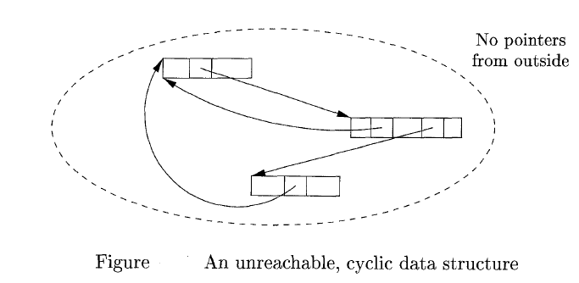
The concept of deferred reference counting has been proposed as a means to eliminate the overhead associated with updating the reference counts due to local stack accesses. That is, reference counts do not include references from the root set of the program.
An object is not considered to be garbage until the entire root set is scanned and no references to the object are found.
The advantage of reference counting, on the other hand, is that garbage collection is performed in an incremental fashion

Slide 75
Symbol Table

Slide 76
Symbol table: A symbol table is a data structure used by a language translator such as a compiler or interpreter, where each identifier in a program's source code is associated with information relating to its declaration or appearance in the source, such as its type, scope level and sometimes its location.
A symbol table is a major data structure used in a compiler which associates attributes with identifiers in a program.
A symbol table information is used by the analysis and synthesis phases to verify that used identifiers have been defined (declared), to verify that expressions and assignments are semantically correct (type checking), to generate intermediate or target code.

Slide 77
Operations:
• Search: whether a name has been used.
• Insert: add a name.
• Delete: remove a name when
Other operations can be added depending on requirement.

Slide 78
Insert
This operation is more frequently used by analysis phase, i.e., the first half of the compiler where tokens are identified and names are stored in the table.
This operation is used to add information in the symbol table about unique names occurring in the source code.
The format or structure in which the names are stored depends upon the compiler in hand.
An attribute for a symbol in the source code is the information associated with that symbol.

Slide 79
This information contains the value, state, scope, and type about the symbol.
The insert function takes the symbol and its attributes as arguments and stores the information in the symbol table.
For example:
int a;
should be processed by the compiler as:
insert(a, int);

Slide 80
lookup
lookup operation is used to search a name in the symbol table to determine:
- if the symbol exists in the table.
- if it is declared before it is being used.
- if the name is used in the scope.
- if the symbol is initialized.
- if the symbol declared multiple times.
The format of lookup function varies according to the programming language.

Slide 81
The basic format should match the following:
lookup(symbol)
This method returns 0 zero if the symbol does not exist in the symbol table. If the symbol exists in the symbol table, it returns its attributes stored in the table.

Slide 82
Implementations
Unordered list:
. for a very small set of variables;
. coding is easy, but performance is bad for large number of variables.
Ordered linear list:
. use binary search;
. insertion and deletion are expensive;
. coding or implementation is relatively easy.

Slide 83
Binary search tree:
. O(log n) time per operation (search, insert or delete) for n variables;
. coding is relatively difficult.
Hash table:
. most commonly used;
. very efficient provided the memory space is adequately larger than the number of variable
. performance maybe bad if unlucky or the table is saturated;
. coding is not too difficult.

Slide 84
Contents in a symbol table
Possible entries in a symbol table:
• Name: a string.
• Attribute:
Reserved word
Type name
Procedure name
Constant name
• Data type.
• Storage allocation, size, . . .
• Scope information: where and when it can be used.
<symbol name, type, attribute>

Slide 85
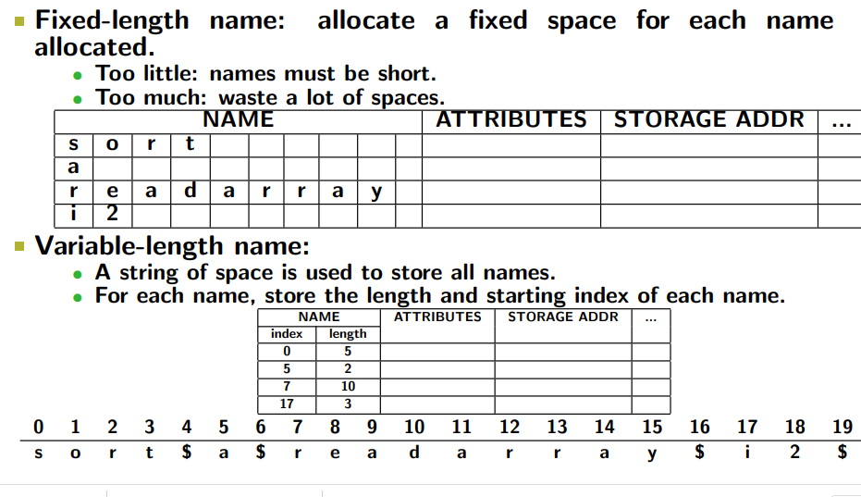

Slide 86
Scope Management
A compiler maintains two types of symbol tables: a global symbol table which can be accessed by all the procedures and scope symbol tables that are created for each scope in the program.
To determine the scope of a name, symbol tables are arranged in hierarchical structure as shown in the example below:

Slide 87
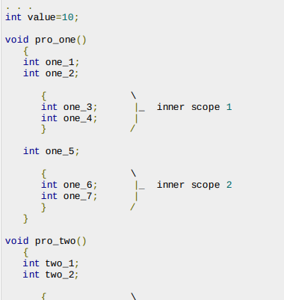
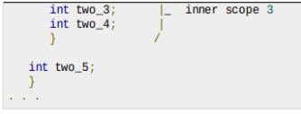

Slide 88
The global symbol table contains names for one global variable int value and two procedure names, which should be available to all the child nodes shown above.
The names mentioned in the pro_one symbol table and all its child tables are not available for pro_two symbols and its child tables.
This symbol table data structure hierarchy is stored in the semantic analyzer and whenever a name needs to be searched in a symbol table
It is searched using the following algorithm:
- first a symbol will be searched in the current scope, i.e. current symbol table.
- if a name is found, then search is completed,
- else it will be searched in the parent symbol table until,
- either the name is found or global symbol table has been searched for the name.

Slide 89
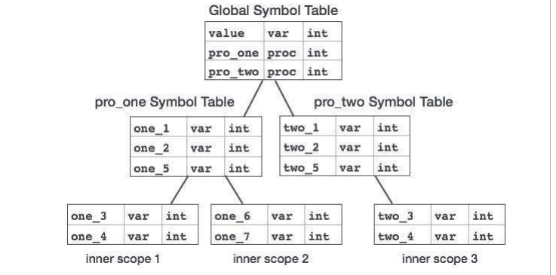

Slide 90
